Slide 1
MGS 425 (S1S & S2S)
Management of it projects
Week 13 – April 26th

Slide 2
Agenda
Chapter 22 – Sprint Retrospective
Chapter 23 – The Path Forward
Final Assignment in TopHat is due on Sunday, May 2nd by 11:59 pm
Class time next week will be used as open office hours to discuss last minute questions or concerns regarding the final term paper.
Final term paper deliverable is to be submitted in UBlearns by Friday, May 7th at 11:59 pm.
  See assignment detail and video for additional information.

Slide 3
Sprint Retrospective
Chapter 22

Slide 4
Sprint Review
Chapter Outline
Overview
Participants
Prework
  Define the Retrospective Focus
  Select the Exercises
  Gather Objective Data
  Structure the Retrospective

Slide 5
Sprint Review
Chapter Outline
Approach
  Set the Atmosphere
  Share Context
  Identify Insights
  Determine Actions
  Close the Retrospective
Follow Through
Sprint Retrospective Issues
Closing

Slide 6
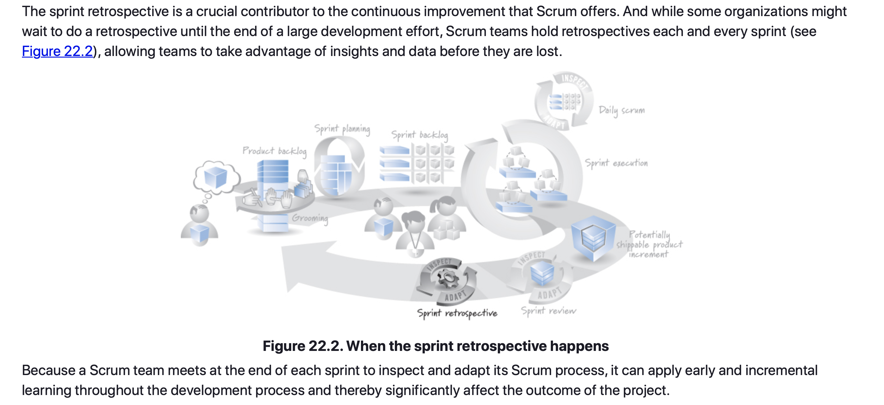
Sprint Retrospective – Overview

Slide 7
Sprint Retrospective – Participants
Participants
Because the sprint retrospective is a time to reflect on the process, we need the full Scrum team to attend.
This includes all members of the development team, the ScrumMaster, and the product owner.
The development team includes everyone who is designing, building, and testing the product. Collectively, these team members have a rich and diverse set of perspectives that are essential for identifying process improvements from multiple points of view.
Stakeholders or managers who are not on a Scrum team, on the other hand, should attend a retrospective only if invited by the Scrum team.

Slide 8
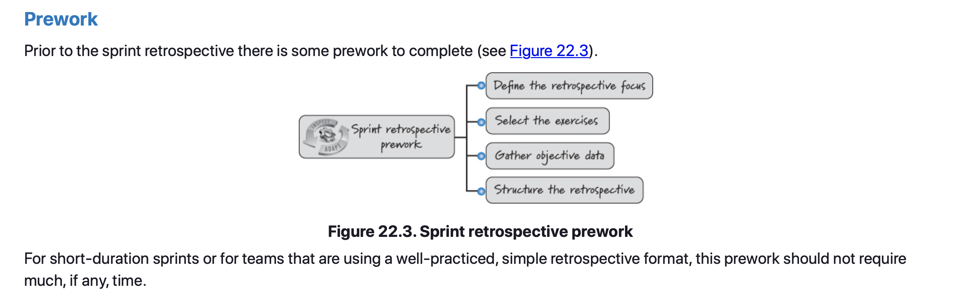
Sprint Retrospective – Prework

Slide 9
Sprint Retrospective – Prework
Define the Retrospective Focus
Each sprint retrospective should have a well-defined focus. The default focus is to review all relevant aspects of the process the Scrum team used during the current sprint. However, there are times when a team might select a different retrospective focus based on what is currently important to the team and where it is energetic about seeing improvement. For example:
  Focus on how to improve our skills with test-driven development (TDD).
  Focus on why we build what we think the customers want, but when they see it they frequently believe we misunderstood their desires or missed an important facet of the requirement.
Establishing and communicating the focus before the start of the retrospective allow the Scrum team to determine if any non-Scrum team members should be invited and also allows the team to prepare for the discussion.

Slide 10
Sprint Retrospective – Prework
Select the Exercises
Once we have established the focus and final participants for the upcoming retrospective, we can determine which exercises might help participants to engage, think, explore, and decide together. A typical retrospective includes the following exercises:
  Create and mine a sprint event timeline.
  Brainstorm insights.
  Group and vote on insights.
However, we might choose to vary these exercises to support a particular focus or set of participants. We might also decide to try new exercises to keep things fresh. See Project Retrospectives (Kerth 2001) and Agile Retrospectives (Derby and Larsen 2006) for additional exercises.

Slide 11
Sprint Retrospective – Prework
Gather Objective Data
Because a sprint retrospective is performed in a focused, short period of time (establish a timebox), any legwork to collect needed data should be done before the retrospective begins.
We know both the focus and the exercise options for the upcoming retrospective, so we should have a good idea of what, if any, objective data should be gathered.
Objective data is hard data (not opinions), such as what events happened and when, or counts of the number of PBIs that were started but not finished, or the feature burnup chart for the sprint illustrating the flow of completed work.
At this point we are not organizing or analyzing any data; we are just collecting it so that it is available during the retrospective.

Slide 12
Sprint Retrospective – Prework
Structure the Retrospective
Like sprint reviews, retrospectives should occur at the end of each sprint, often immediately following the sprint review, and generally should recur at the same place, day, and time each sprint.
Although the ScrumMaster will often act as and can be quite effective as the facilitator for the sprint retrospective, any capable team member can fulfill the role of retrospective facilitator.
There are also times when bringing in a skilled, neutral, outside facilitator might be the best solution to help team members either get started doing retrospectives or to assist them through a particularly difficult or sensitive retrospective where a closely aligned, internal facilitator may be far less successful.

Slide 13
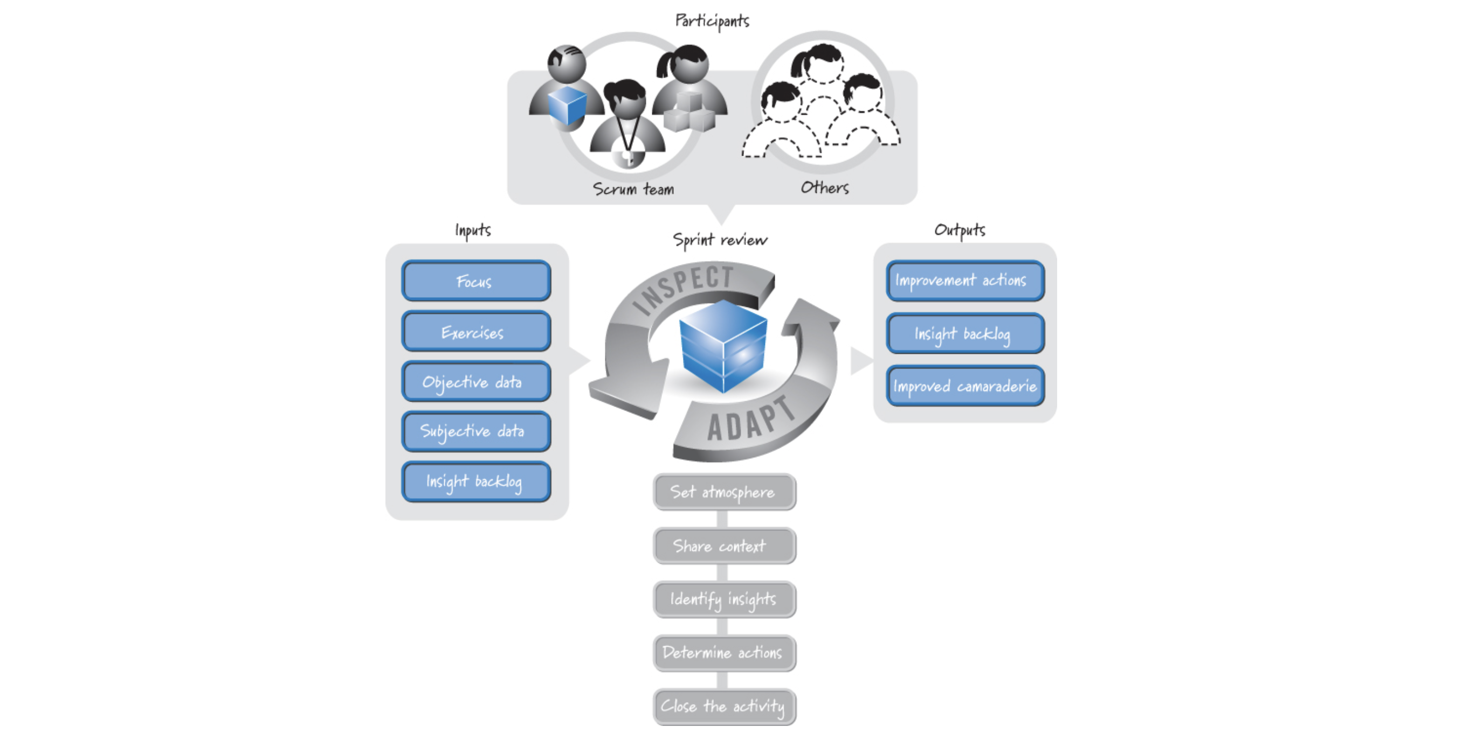
Sprint Retrospective – Approach

Slide 14
Sprint Retrospective – Approach
Approach
While many retrospective approaches exist, most seek to answer the following questions:
  What worked well this sprint that we want to continue doing?
  What didn’t work well this sprint that we should stop doing?
  What should we start doing or improve?
An approach (similar to one described by Derby and Larsen 2006) that may be useful is to set the atmosphere for the retrospective, create a shared context among the participants, identify insights that can lead to improvements, determine concrete improvement actions to take during the next sprint, and close the retrospective.

Slide 15
Sprint Retrospective – Approach
Set the Atmosphere
During a retrospective, people are being asked to analyze the behavior and performance of their team and to make specific recommendations for how the team can improve itself.
Putting the team (and by extension oneself) under a microscope can be an uncomfortable experience.
So, a good way to start the retrospective is to establish an atmosphere that makes people feel comfortable participating.
People must feel it is safe to express their opinions without fear of retribution.

Slide 16
Sprint Retrospective – Approach
Set the Atmosphere
Teams should have established ground rules, or a working agreement, which make it clear that expressing opinions and airing dirty laundry are safe things to do.
It is helpful for the ground rules to make clear that the focus is on the organizational system and process, not the individuals, thus making it safe to explore what went wrong.
There will be times when problems are people problems; the retrospective is not the place to solve them. The retrospective is about improving the Scrum team’s process, not about assigning blame or reprimanding individual behavior.
When setting the atmosphere, ensure that the ground rules reinforce the concept of a blame-free environment.

Slide 17
Sprint Retrospective – Approach
Share Context
A group of people can all experience the same event and yet interpret it quite differently. To successfully inspect the current sprint, it is important to get everyone on the same page so that they have a shared context.
To establish a shared context the participants must align their diverse individual perspectives into a shared team perspective.
When establishing a shared context, therefore, it’s imperative to first ground the retrospective in an objective, big-picture view of the sprint.
After getting everyone in a talking mood, share objective data, such as committed PBIs, PBIs completed, number of defects, and so on.
Two of the most common ways to develop a shared context are an event timeline and an emotions seismograph.

Slide 18
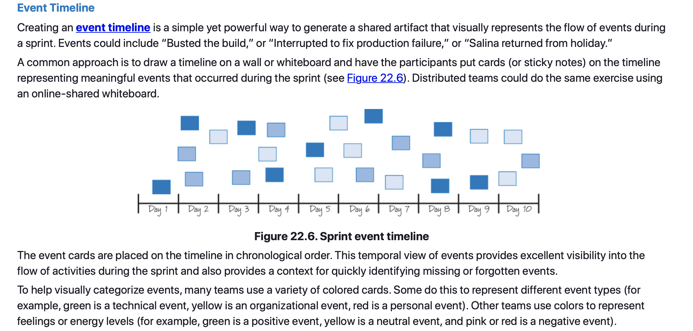
Sprint Retrospective – Approach

Slide 19
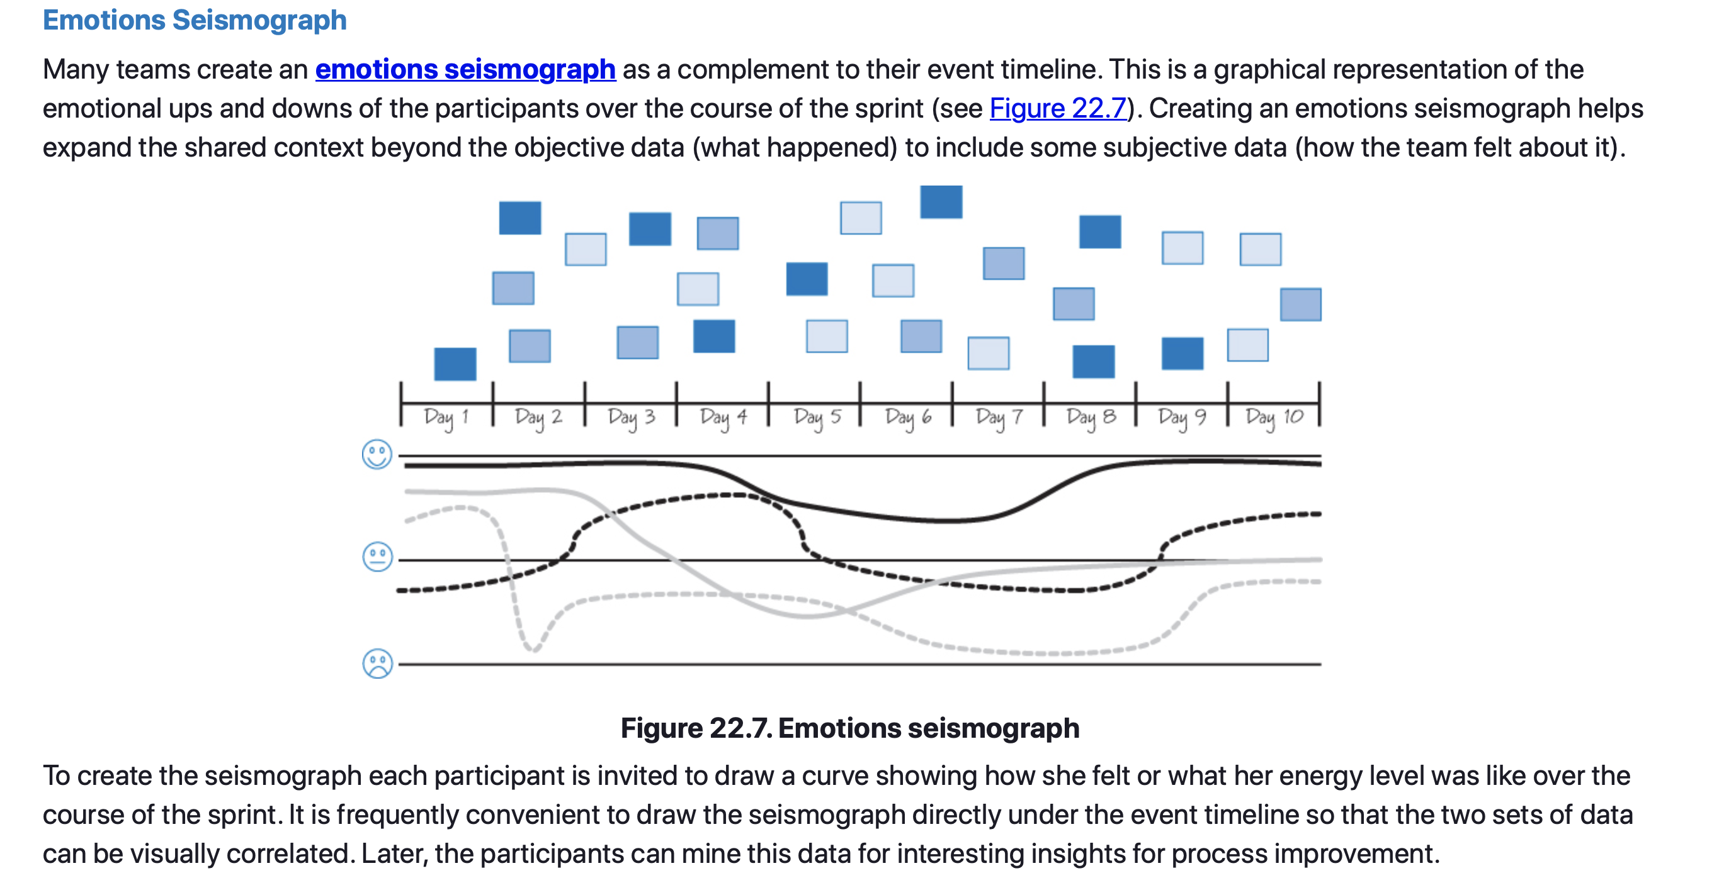
Sprint Retrospective – Approach

Slide 20
Sprint Retrospective – Approach
Identify Insights
Once a shared context has been established, the participants can thoughtfully examine, understand, and interpret the data to identify process improvement insights.
The participants should start by mining the shared context data. For example, they could look at their event timeline and emotions seismograph and ask the following questions to help uncover insights:
  What worked well?
  What didn’t work well?
  Where are some opportunities to do things differently?
Frequently participants are asked to brainstorm insights and then capture them on cards and place them on a shared wall or other surface so that everyone can see them.

Slide 21
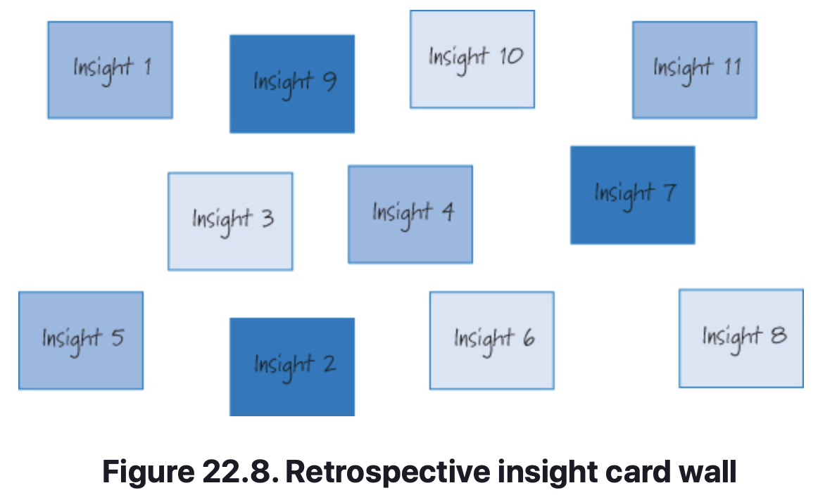
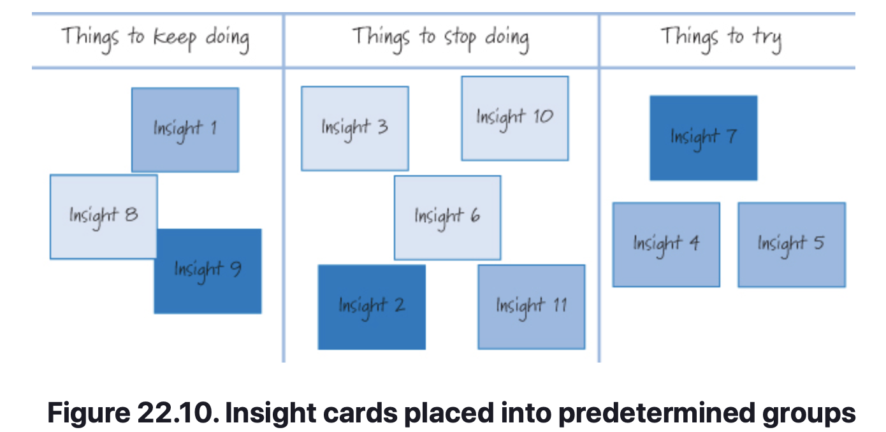
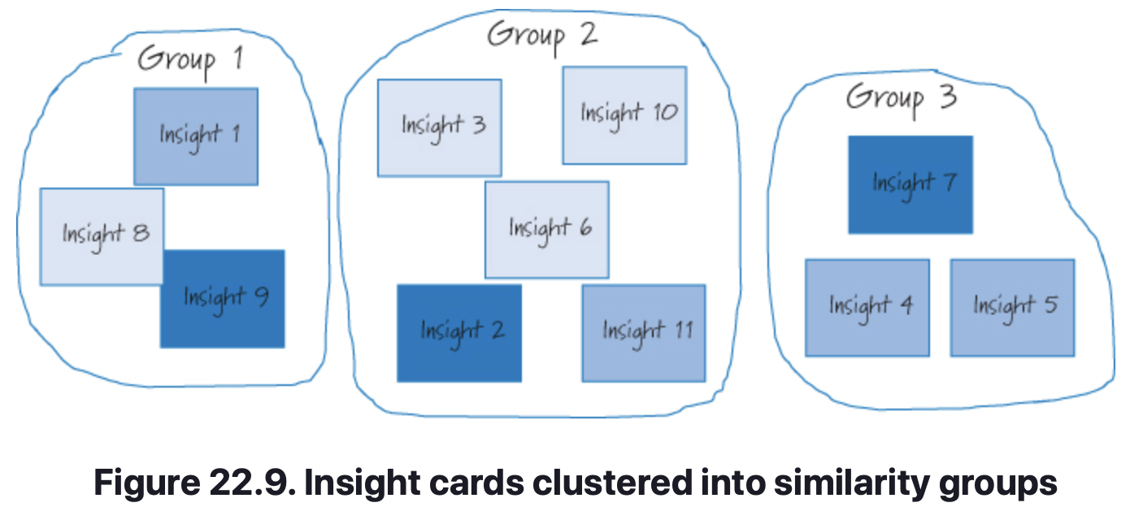
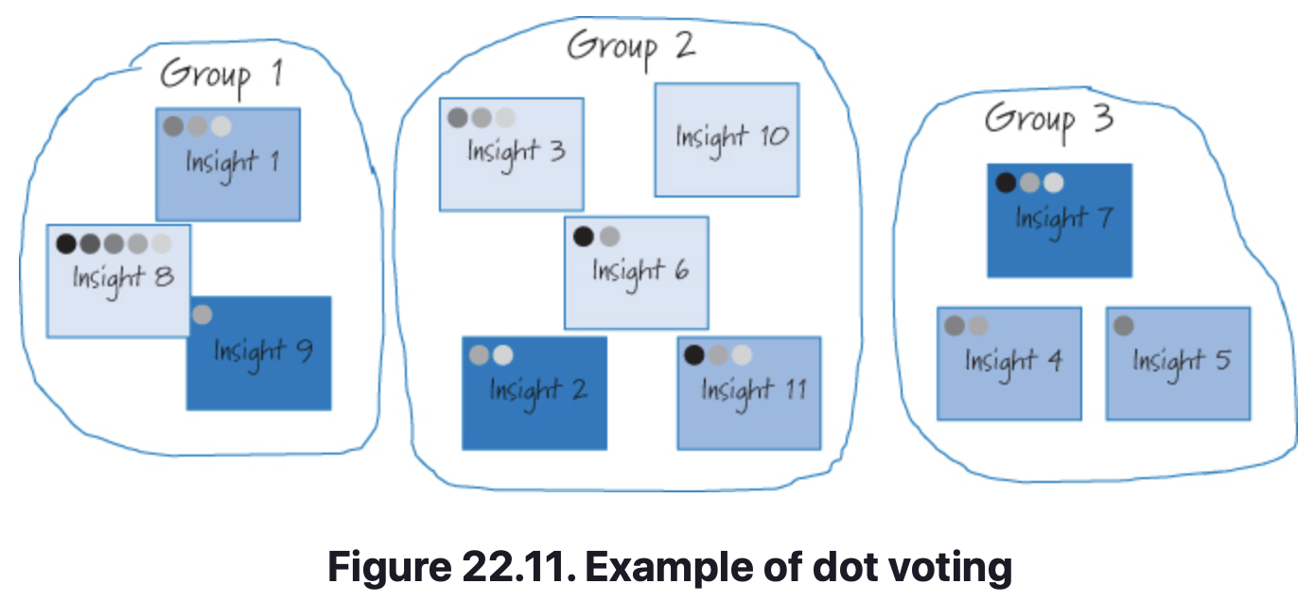
Sprint Retrospective – Approach/Insights

Slide 22
Sprint Retrospective – Approach/Insights
Decide on Actions
At this point we have prioritized our insights and have some idea of the capacity we have to work on them.
However, we get no measurable value from the retrospective until we define concrete, actionable steps to leverage our insights and improve the Scrum process.
Most actions will take the form of specific tasks that one or more Scrum team members will perform during the upcoming sprint.
The team should determine who can do this work and how much time the work will take. Only then can the team be sure that working on a particular insight is doable within the available capacity.
Notes:
For example, if the insight is “It takes too long to determine when the code build breaks,” the action might be “Have the build server send an email when the build is broken.” This action requires task-level work on the part of one or more development team members.

Slide 23
Sprint Retrospective – Insight Backlog
Insight Backlog
Some teams create an insight backlog (sometimes called an improvement backlog) to hold any issues that are identified during a retrospective but cannot be worked on immediately.
The idea is that at the next sprint retrospective the participants can choose to use the insights in the backlog as candidates to be prioritized against new insights when determining where to focus time in the next sprint.
The insight backlog should be groomed periodically to ensure that its contents remain valuable insights.
Other teams simply discard any insights that they choose not to work on in the next sprint.
The thinking is that if an insight is truly important, it will be identified again at the next retrospective.

Slide 24
Sprint Retrospective – Approach/Insights
Close the Retrospective
Once the final improvement actions have been determined, the participants close out the retrospective.
Many close by recapping what actions the team has decided to take based on what the participants learned. This might be as simple as describing each committed action item and who is going to work on it.
Closing is also a good time to appreciate people and their participation.
Each participant should say a few kind words of appreciation regarding the contributions made by others, both within the Scrum team and outside the team.
Finally, it’s a good idea to spend a few minutes asking the team for suggestions to improve the team’s approach to performing a retrospective.

Slide 25
Sprint Retrospective – Follow Through
Follow Through
To ensure that what happens in the sprint retrospective does not just stay in the sprint retrospective, the participants should follow up on the actions they chose to complete.
Frequently the easiest way to handle the improvement actions is to populate the sprint backlog with tasks corresponding to each action prior to bringing in new features.
The team’s available capacity to work on new features would then be adjusted downward by the estimated time these improvement tasks will take.
Any approach that allows the team to make a good commitment at sprint planning while at the same time affording it the opportunity to work on the improvement actions is a good approach.

Slide 26
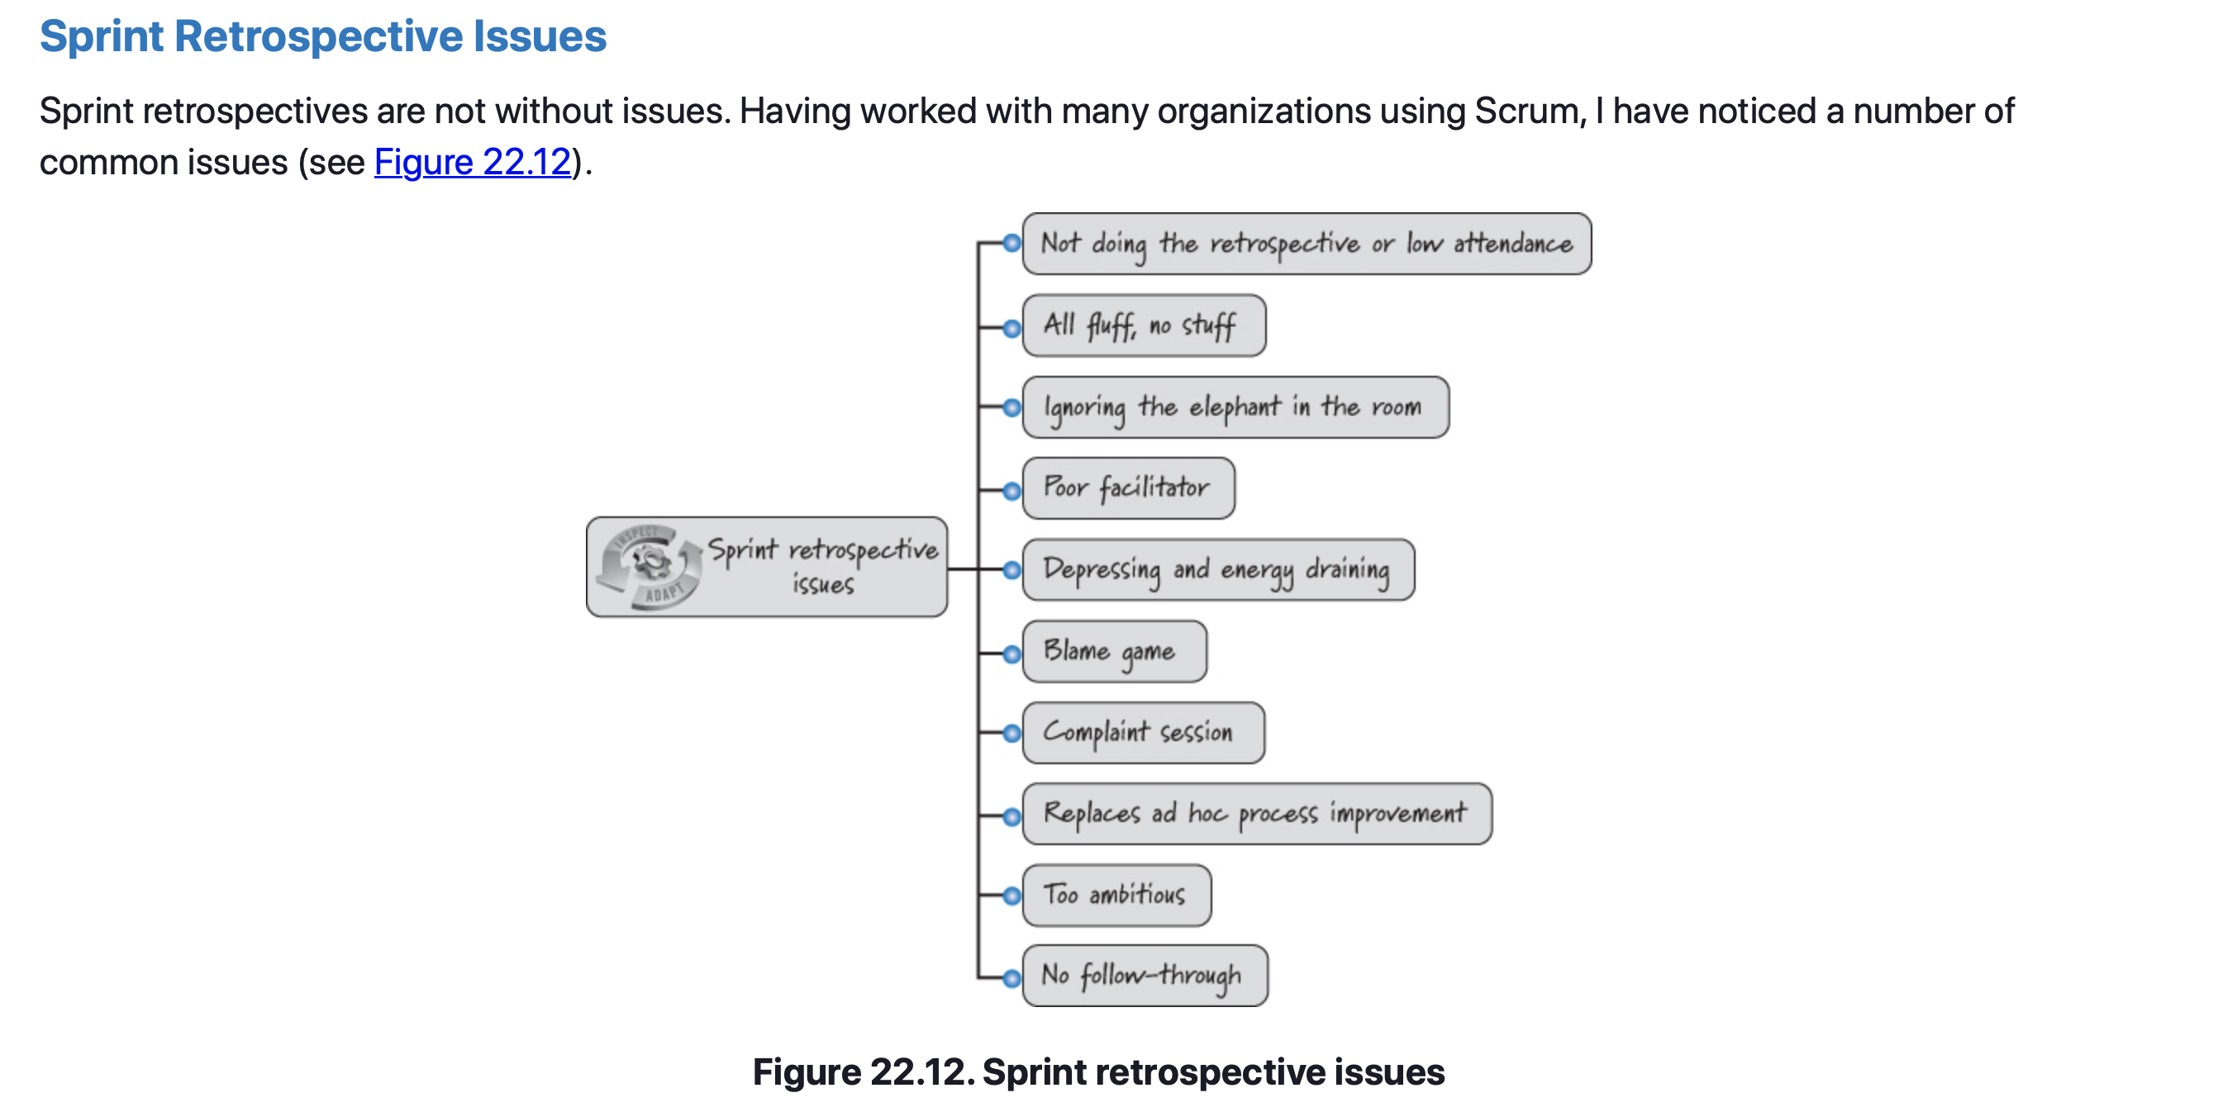
Sprint Retrospective – Issues

Slide 27
Sprint Retrospective – Closing
Sprint retrospectives are a time for the team to reflect on how well it is using Scrum and to propose improvements.
The retrospective is a collaborative activity among the Scrum team members (and any non–Scrum team members on an as-needed basis).
Once the retrospective prework is completed, the basic flow of the retrospective is to set the atmosphere to have a successful retrospective, get everyone on the same page by creating a shared context grounded in data, identify improvement insights, determine improvement actions, and then close the retrospective.
After closing the retrospective, it is critical that the participants follow up and carry out the improvement actions so that the team is more effective during the next sprint.
It is also important to keep a watchful eye out for issues that might prevent the retrospective from being successful and to quickly act on them.

Slide 28
The Path Forward
Chapter 23

Slide 29
The Path Forward
Chapter Outline
There Is No End State
Discover Your Own Path
Sharing Best Practices
Using Scrum to Discover the Path Forward
Get Going!

Slide 30
The Path Forward
There is No End State
Up to this point, we have laid out the Scrum framework and explained what is believed to be essential Scrum.
Students should now understand the mechanics of using Scrum to deliver innovative solutions and also have a good sense of why Scrum prescribes particular roles, practices, artifacts, and rules.
Now we are ready to define the path forward.
This chapter discusses the idea that there is no universal, final target for a Scrum implementation; instead, organizations need to define their own unique route towards agility.
We end by describing the role of best practices and how to use Scrum, with its iterative and incremental approach, as the basis for discovering a unique path forward.

Slide 31
The Path Forward
There is No End State
Every organization has a vision for what it wants to achieve.
Using Scrum can help organizations manage the work to achieve that vision.
Being highly proficient with Scrum and thus being more agile, however, is not the end goal, but rather a means of more effectively and economically achieving business goals.
There is no definition of done for a Scrum adoption or transition effort, such that exists with a maturity model like CMMI (SEI 2010), where the goal is to try to reach level 5.
Trying to define “done” for your Scrum implementation presumes that when you achieve that state, you can’t get any better. This flies in the face of Scrum being a form of continuous improvement, where you are always working to better align your use of Scrum to the complex world in which you must develop products.

Slide 32
The Path Forward
Discover Your Own Path
Just as no one can tell you where your Scrum implementation should end, no one can lead you down a predefined path that will guarantee success.
Instead, you must learn, inspect, and adapt your way forward based on your organization’s own unique goals and culture and the ever-changing complex environment in which you must operate.
Trying to follow someone else’s path and leveraging their learning might feel like the fast track to becoming agile.
However, no two organizations, or even teams within an organization, are the same.
Following someone else’s path might well lead you to precisely the wrong location.
Continuously inspect and adapt based on what was learned.

Slide 33
The Path Forward
Sharing Best Practices
If we aren’t supposed to follow others’ paths, how do best practices fit into the picture? Just as there is no one path to follow, there is no one set of best practices across all organizations.
Best practices are relevant in the context of the other organizations so that the people who are asking can evaluate whether it would be sensible to adopt a similar approach in their organization.
Even when scaling up within a single organization, we need to be cautious about universally applying best practices.
Many organizations try to describe what a successful Scrum team is doing, capture it, and then institutionalize it as a best practice.
Doing so can be harmful, because these are individual team approaches that may not work for other teams.

Slide 34
The Path Forward
Using Scrum to Discover the Path Forward
One example of how an organization implemented a phased approach to Scrum is by requiring any new team that was going to use Scrum should have a coach available to help it.
With limited initial coaching capacity, it was unreasonable to transition the entire IT organization over to Scrum at once.
So, as is typical in such environments, the organization selected a small number of pilot efforts to focus on first.
The goal was to incrementally move other teams over to Scrum as the organization’s Scrum coaching capacity increased via the on-the-job training of internal coaches.

Slide 35
The Path Forward
Using Scrum to Discover the Path Forward
These pilot efforts crossed the spectrum from simple systems maintenance to larger, new-product development.
Based on this diversity, each Scrum team implemented its own version of the Scrum framework, using approaches aligned with the people on the team and the work they had to perform.
A wiki was used to “syndicate” the approaches used by each team to assist with overall organizational learning and share what was working for other teams.
Scorecards can be used to objectively measure KPI’s (key performance indicators) in terms of how each team is progressing.
After several months progression into the adoption, the organization decided it was time to scale the use of Scrum from the team level to the organizational level.

Slide 36
The Path Forward
Get Going!
When employing Scrum, you shouldn’t worry about getting things perfect up front. You can’t!
And trying to be perfect up front will force you to guess at the expense of important learning that you will get only by applying Scrum and seeing what happens.
In the author’s experience, most teams’ first couple of sprints aren’t all that pretty. That’s OK. His words…
“My only expectation of any Scrum team is that it be better in the next sprint than it was in the previous sprint. So, don’t delay getting started. Whatever you think you know now about your use of Scrum, imagine how much more you will really know after you start and finish the next sprint!”

Slide 37
Sprint Retrospective
Sources
Unless otherwise noted, all material in these slides were used from the textbook for this course:
Rubin, Kenneth S., Essential Scrum: A Practical Guide to the Most
Popular Agile Process, 1st Edition. Addison-Wesley Professional; 1st
edition (August 5, 2012). ISBN-13: 978-0137043293.

